Slide 1
Riparian areas
Filtering out excess nutrients.

Slide 2
Constructed Wetland
Nutrient treatment wetlands – AKA “constructed wetlands” –
Edge-of-field practice
Designed and installed under the Conservation Reserve Enhancement Program (CREP)
CREP wetlands are primarily designed to treat runoff from cropland
Shown to improve water quality by reducing nitrate by an average of 52%
Provide
wildlife habitat,
recharge groundwater,
reduce flooding downstream by storing runoff
provide recreational opportunities.
Soak up water, controlling periods of flood and re-releasing it when necessary.
Slow down the flow of water across a landscape, removing contaminants from flowing water
Microbes associated with wetland plants efficiently remove nitrates

Slide 3
Nutrient Reduction Strategy
https://youtu.be/cu7h5iI79Ek
What is the Nutrient Reduction Strategy?
What are wetlands and riparian areas?
How can they help the Nutrient Reduction Strategy?

Slide 4
Constructed Wetland

Slide 5
Constructed Wetland
Man-made features that mirror the natural function and benefit of wetlands
Utilize ditch plugs, dams, levees, dikes, and dugouts
Grade or level land with machinery
Plug subsurface drain tile or install water level control structure
Plant native shrubs, trees, grasses
Direct water flow with pipes, chutes, berms, and weirs
More than 70 constructed wetlands have been installed in Iowa
Estimated that Iowa needs about 7,000 CREP wetlands to fully implement the Iowa Nutrient Reduction Strategy
Systems typically include a 5 to 10 acre wetland, surrounded by a 30 to 40 acre grass buffer
Systems typically handles water from roughly 1,000 acres
One CREP wetland provides roughly the same amount of nitrate removal from 1,000 acres as converting 500 acres to permanent grass.

Slide 6
Wetlands

Slide 7
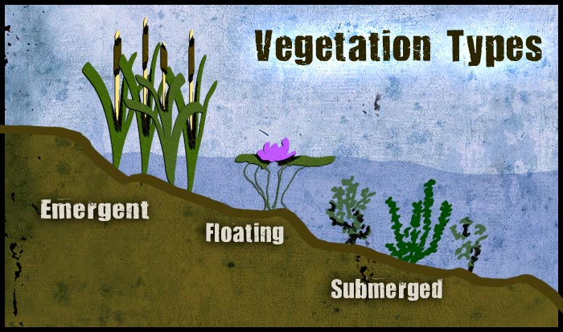
Vegetation types in wetlands
Emergent – plants that grow mostly out of the water
Floating – plants with primary photosynthesizing leaves float on the surface of the water
Submerged – plants just below the surface of the water
Image credit: Untamed Science

Slide 8
Wetlands
https://youtu.be/WiunOOoFwTE

Slide 9
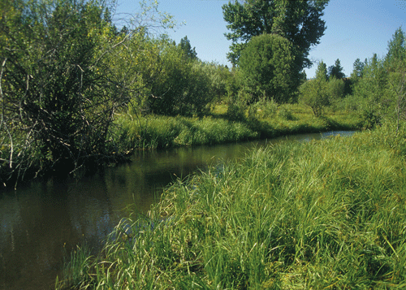
Riparian Areas
Occur along watercourses and water bodies.
flood plains
streambanks and river banks
Adjacent to ditches, canals, ponds, lakes, and reservoirs
Different from surrounding lands because of unique soil and vegetation characteristics influenced by the presence of water
General indicators of riparian areas include:
Vegetation: kinds and amounts of vegetation differ from adjacent upland vegetation because more water is supplied to plants
Soil: stratified sediments of varying textures that are subject to intermittent flooding or fluctuating water tables
Water: direct influence by water from a watercourse or water body.

Slide 10
Riparian Areas Value
Hydrology (movement of water)
Ground water is generally nearer to the surface and available for plants.
Fine-textured sediments are able to hold large amounts of water.
Nutrient-rich ecosystem with sedimentation of organic matter and dissolved nutrients in the water.
Periodic flooding allows water to move through soils enhancing the recycling of nutrients and other chemical reactions beneficial to plant growth.
The timing of flooding enhances survivability of organisms, promotes species diversity, and biological productivity.
Base flow (normal water flow in a river or stream)
Alluvial soil, which is sedimentary material deposited by flowing water, is usually deep and stores large amounts of water from rainfall and runoff.
Water flowing in a stream that is due to ground water seepage into the channel is maintained by riparian vegetation that shades the water, keeping it cooler and slowing evaporation.
Nutrient cycling
Nutrients are exposed to mechanisms that may use or change them.
Nitrogen, phosphorus, calcium, magnesium, and potassium, are taken up by shallow-rooted riparian vegetation.
Dissolved nutrients moving with the ground water and those that are leached in the soil may be taken up by deeper-rooted riparian vegetation.
Some nutrients pass through without being detained, and some may be reintroduced into the water column when the vegetation dies and decomposes.

Slide 11
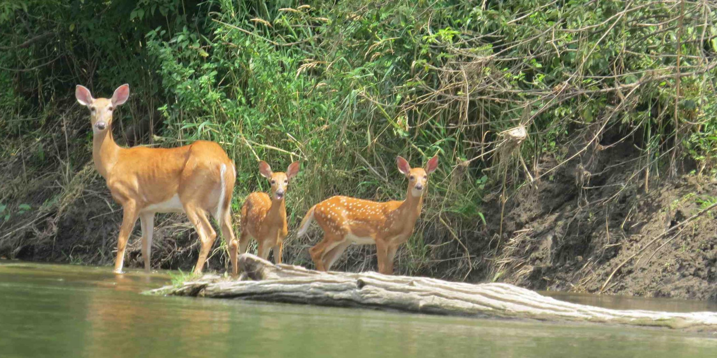
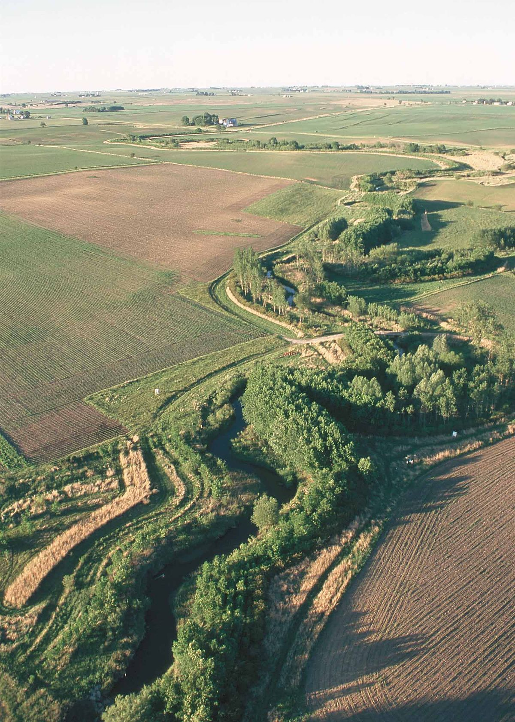
Riparian Areas Value
Energy transfer
Energy from dead plant matter (litter) is made available to in-stream animal communities to use and those downstream.
Downstream flooding
Reduces downstream flooding.
Plants resist the flow and dissipate the energy.
Increase the time available for water to infiltrate into the soil and be stored for use by plants.
Water quality
Reduced water velocities allow for sediment and organic matter to settle out of water.
Aquatic life
Rooting herbaceous and woody vegetation provide habitat and stabilizes streambanks.
Plants reduce erosion and can create overhanging banks that serve as habitat for fish.
Terrestrial life
Extremely productive and have diverse wildlife.
Provides corridors for migratory wildlife as forested connectors between habitats.

Slide 12
Riparian Areas
https://youtu.be/wgVDukA6Ays

